Slide 1

Welcome to Year 1
2024-2025

Slide 2
Key adults
Miss Bovington- Class Teacher
Mrs Nash- Class LSA
Ms Russell- Class LSA (Monday and Tuesday mornings)
Mrs Ditta (Tuesday afternoons- SALT)
Mrs Davey- PPA cover Monday afternoons

Slide 3


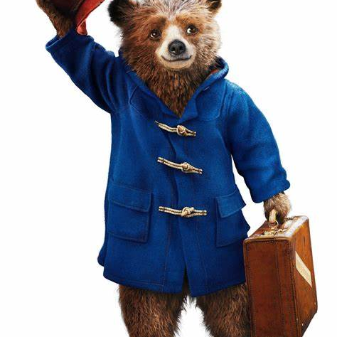


English/Phonics
Consists of;
Speaking
Listening
Reading
Handwriting
Spelling

Slide 4
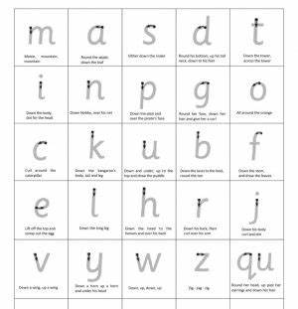
Handwriting expectations
All lower case letters formed correctly
• Write capital letters taller than lower case letters
• Write on the lines
• Write descenders under the line all the same length
(f, g, j, p, q, y)
• Write ascenders taller than other lower case letters and make them all the same height (b, d, h, k, l, t)
Support in school – daily handwriting practice, pencil grips, extra 1:1 interventions if needed

Slide 5


Reading
RWI Phonics - We teach reading and phonics through the Read, Write, Inc (RWI). This is taught in class 5 days a week for half an hour
An adult will read a book with your child once a week and write a comment in their reading diary
Your child will change their book once they have read it twice
Please sign and date when you have read with your child at home to ensure they are considered a raffle prize

Slide 6
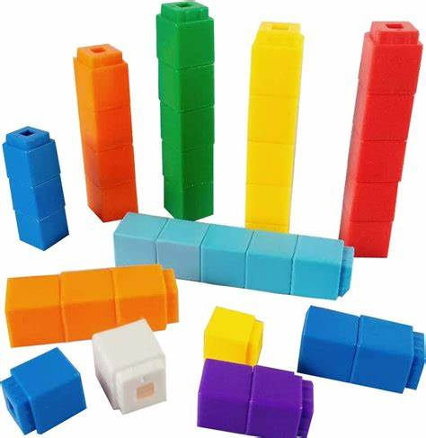
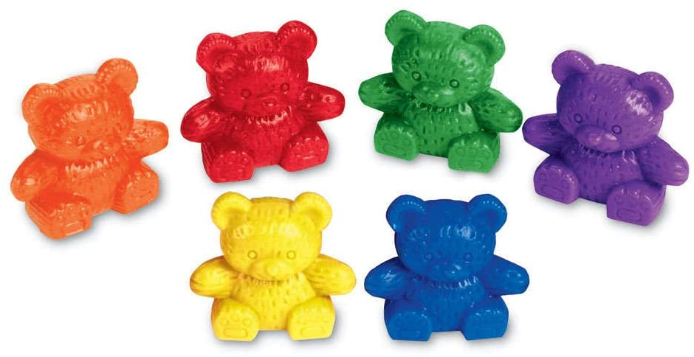
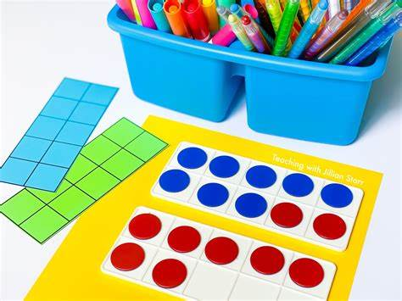
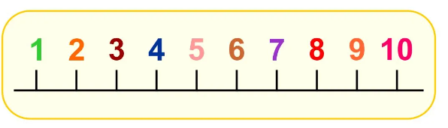
Maths
Count forwards and backwards in 1s within 100 starting at any number.
Count forwards and backwards in 2s, 5s and 10s.
Know 1 more and 1 less than a given number up to 100.
To understand place value of a number within 100 – how many tens and ones.
To fluently recall number bonds to 10 and 20.
To fluently add and subtract numbers within 10 understanding the relationship of parts and wholes.
Add and subtract numbers within 100 using concrete resources and pictures.
Fluently recall the related addition and subtraction facts up to 20.
2-digit add and subtract 1-digit not crossing 10s
e.g. 36 + 3 = 75 - 2 =
Understand mathematical symbols + - and =
Use the language of comparisons (greater than / less than).
Measure weight, length and capacity.
Recognise and describe simple 2D and 3D shapes.
Tell the time (half past, o'clock).
Recognise half, quarter and whole of amounts, shapes and number (1/2).

Slide 7


Science
Identifying changes throughout the seasons
Comparing objects and their properties

Slide 8


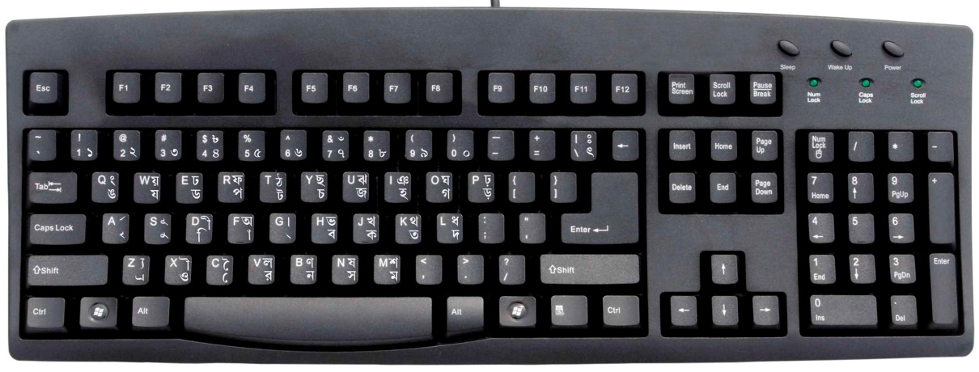
Computing

Slide 9
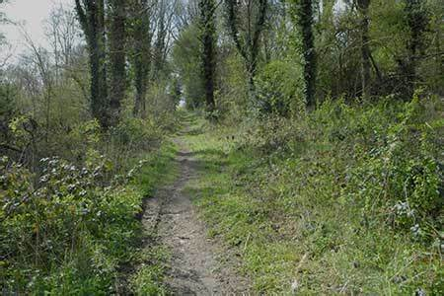
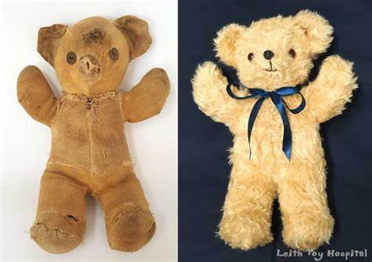
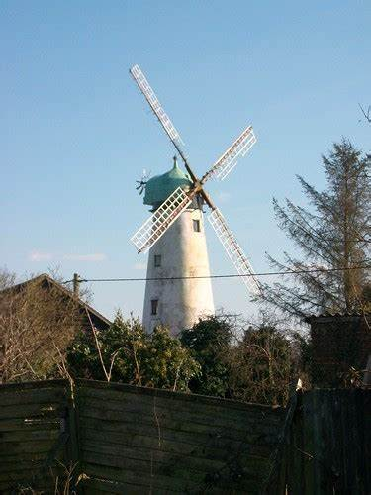
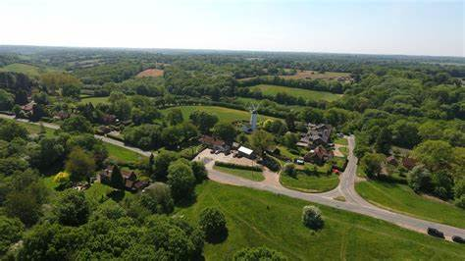
History and Geography
Toys throughout Time
Our Local Area

Slide 10

RE
What makes us special?
Key stories to deepen their understanding of Harvest Festival and Christmas

Slide 11

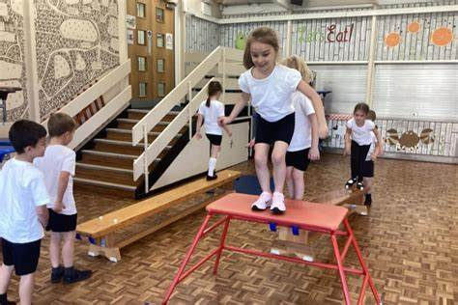
PE/Game On
Game on –Thursdays
PE- Mondays and then Fridays after Forest School
Throwing and catching
Team work
Gymnastics

Slide 12
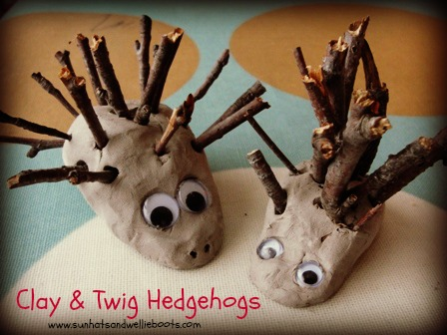

Art and DT
Colour theory and printing techniques
Forest School
Clay hedgehogs

Slide 13

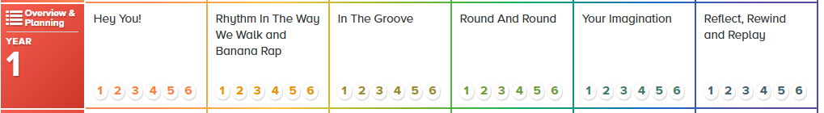
Music
Rhythm, pulse, pitch, singing, dancing and composing
Genres: Hip-hop, Reggae, Blues, Baroque, Latin, Bhangra, Folk, Funk, Bossa Nova, Classical and Pop

Slide 14

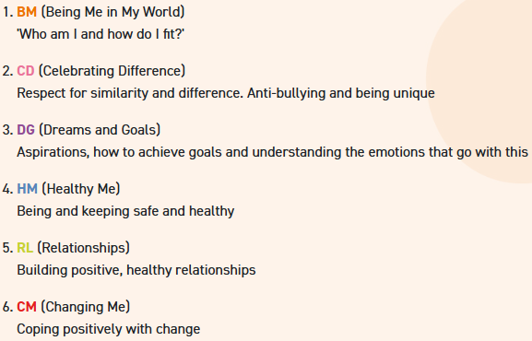

PSHE

Slide 15

Homework
Homework consists of;
Reading (5 x per week)
Phonics (Oxford owl and Phonics play)
Maths or English activity
Spellings in Spring Term 2 (after February half term)

Slide 16
Curriculum Enrichment
Forest School
Visit from the Chesham Museum- Toys
Walks to the Common
Whole school bulb planting
Harvest Festival
Christmas Nativity
Trips

Slide 17
How can you help?
Forest School
Availability to help with walks to common/ trips
Voluntary readers
Mystery Reader
Parents expertise

Slide 18
Upcoming Key Dates
Kith and Kin- Monday 16th September at 1pm
Bulb Planting- Friday 27th September at 2.45pm
KS1 Harvest Festival- Tuesday 1st October at 10.00am
Phonics parents meeting- Friday 11th October
INSET days- 4th and 5th November
Maths parents workshop- Friday 8th November
Parents evenings: w/c 11th November

